Slide 1
Financing Your Notre Dame Education

Slide 2
FIRST DESTINATION DATA CLASS OF 2019
 | Median Salary | Full-Time Employment | Graduate School | Service Program | Military | Seeking Employment | Other Plans
Architecture | $56,000 | 100% | 0% | 0% | 0% | 0% | 0%
Arts & Letters | $55,000 | 49% | 27% | 13% | 2% | 3% | 6%
Business | $70,600 | 87% | 9% | 1% | 0% | 2% | 1%
Engineering | $72,000 | 81% | 11% | 2% | 3% | 2% | 1%
Science | $60,000 | 40% | 40% | 12% | 2% | 1% | 5%

Slide 3
WHAT DOES IT MEAN TO MEET NEED?
Notre Dame is one of fewer than 60 schools in the U.S. that accepts students based on academic record (need-blind) AND meets need
School Does Not Meet Need
Cost | $78,000
Family Contribution from FAFSA | $4,000
Financial Need | $74,000
School Offer | $74,000
Unmet Need | $0
Family Contribution | $4,000
Cost | $36,000
Family Contribution from FAFSA | $4,000
Financial Need | $32,000
School Offer | $22,000
Unmet Need | $10,000
Family Contribution | $14,000
Body copy here. Georgia regular. This is just placement text. This box can also be used to place objects, instead text. Examples of objects include graphs, tables, images, film, or charts.
Notes:
Need to update

Slide 4
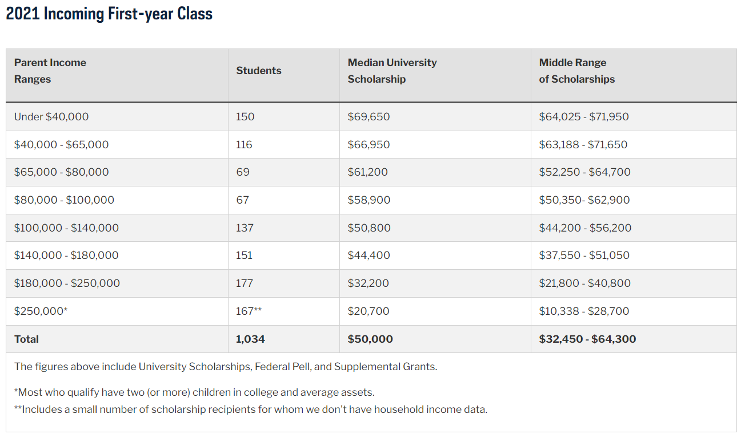
Body copy here. Georgia regular. This is just placement text. This box can also be used to place objects, instead text. Examples of objects include graphs, tables, images, film, or charts.

Slide 5
Applying for Financial Assistance

Slide 6
APPLY FOR FINANCIAL AID
It is not too late to apply for 2022/2023
Two applications required
Free Application for Federal Student Aid (FAFSA) online at fafsa.gov
CSS Profile online at cssprofile.collegeboard.org
The applications use 2020 actual income
Upload supporting documents to:
Institutional Documentation Service (IDOC)
Access IDOC student portal at idoc.collegeboard.org
Check financial aid section of admission portal to confirm all documents have been submitted
Body copy here. Georgia regular. This is just placement text. This box can also be used to place objects, instead text. Examples of objects include graphs, tables, images, film, or charts.

Slide 7
FINANCIAL AID NOTIFICATION PROCESS
Financial Aid Notifications (FAN) mailed in early March and continue to be sent daily
Email sent to student (at the address used on admission application)
Paper packet mailed to home address
Packet includes:
Financial Aid Notification
Personal Planner and Family Responsibility Worksheet
Financial Aid Conditions and Information
Instructions on next steps
Body copy here. Georgia regular. This is just placement text. This box can also be used to place objects, instead text. Examples of objects include graphs, tables, images, film, or charts.

Slide 8
2021/2022 AVERAGE COST OF ATTENDANCE
Billed Costs
Tuition and Fees $58,843
Room and Meals $16,304
Body copy here. Georgia regular. This is just placement text. This box can also be used to place objects, instead text. Examples of objects include graphs, tables, images, film, or charts.
Estimated Expenses
Books and Supplies $1,250
Personal Expenses $1,200
Transportation $ 750

Slide 9
Receiving Financial Assistance

Slide 10
MERIT SCHOLARSHIPS
About 100 first-year students are selected to receive a merit scholarship (based upon admission application)
The Merit Scholars Office extends invitations to semifinalists to apply for merit scholarship in February
Merit scholarships are offered only to entering students; offers are made in April
Provosts’ Scholarship: Merit scholarship based upon demonstrated need. Amount ranges from $2,500 to $7,500
Body copy here. Georgia regular. This is just placement text. This box can also be used to place objects, instead text. Examples of objects include graphs, tables, images, film, or charts.

Slide 11
CAMPUS EMPLOYMENT
The amount of employment eligibility on the Financial Aid Notification is an estimate of what the student might earn. It is not a guarantee of employment or earnings.
Students typically use the money to pay for their personal expenses
Family choice if a students works – we will not replace with gift money
The options for work range from food services to research with faculty
Body copy here. Georgia regular. This is just placement text. This box can also be used to place objects, instead text. Examples of objects include graphs, tables, images, film, or charts.

Slide 12
PRIVATE SCHOLARSHIPS
Since Notre Dame meets demonstrated need so receipt of private scholarship will change offered aid (loan and work reduced first)
Body copy here. Georgia regular. This is just placement text. This box can also be used to place objects, instead text. Examples of objects include graphs, tables, images, film, or charts.

Slide 13
ALUMNI CLUB SCHOLARSHIPS
Club scholarships are based upon demonstrated financial need
Club representatives use a secure website and see a list of admitted students for their area
Amount of club scholarship varies
If selected, student will receive a revised electronic notification from our office
Body copy here. Georgia regular. This is just placement text. This box can also be used to place objects, instead text. Examples of objects include graphs, tables, images, film, or charts.

Slide 14
STUDENT LOANS
Notre Dame Subsidized Loan
Based on financial need
Interest free while enrolled at Notre Dame
If eligible, listed on the Financial Aid Notification
Federal Direct Subsidized Loan
Based on financial need
Interest free if enrolled at least half-time
Federal Direct Unsubsidized Loan
Need is not a factor
Interest accumulates while in school (3.73% currently)
Body copy here. Georgia regular. This is just placement text. This box can also be used to place objects, instead text. Examples of objects include graphs, tables, images, film, or charts.

Slide 15
OTHER FINANCING OPTIONS
Interest-Free Payment Plan Through Nelnet
Interest-free monthly installments
Annual Payment Plan fee of $45 or Semester Plan $25
Flexible options ranging from two to ten months
Federal Direct PLUS Loan
Requires completion of the FAFSA
Online application available late April
Current interest rate 6.28% (set July 1 annually)
Payment begins 60 days after the disbursement of the funds
Private Education Loan
Student is the borrower with a qualified co-signer
Interest accumulates while in school
Body copy here. Georgia regular. This is just placement text. This box can also be used to place objects, instead text. Examples of objects include graphs, tables, images, film, or charts.

Slide 16
QUESTIONS AND ANSWERS
How will this work for your family?
Academic Fit
Social Fit
Financial Fit

